Slide 1
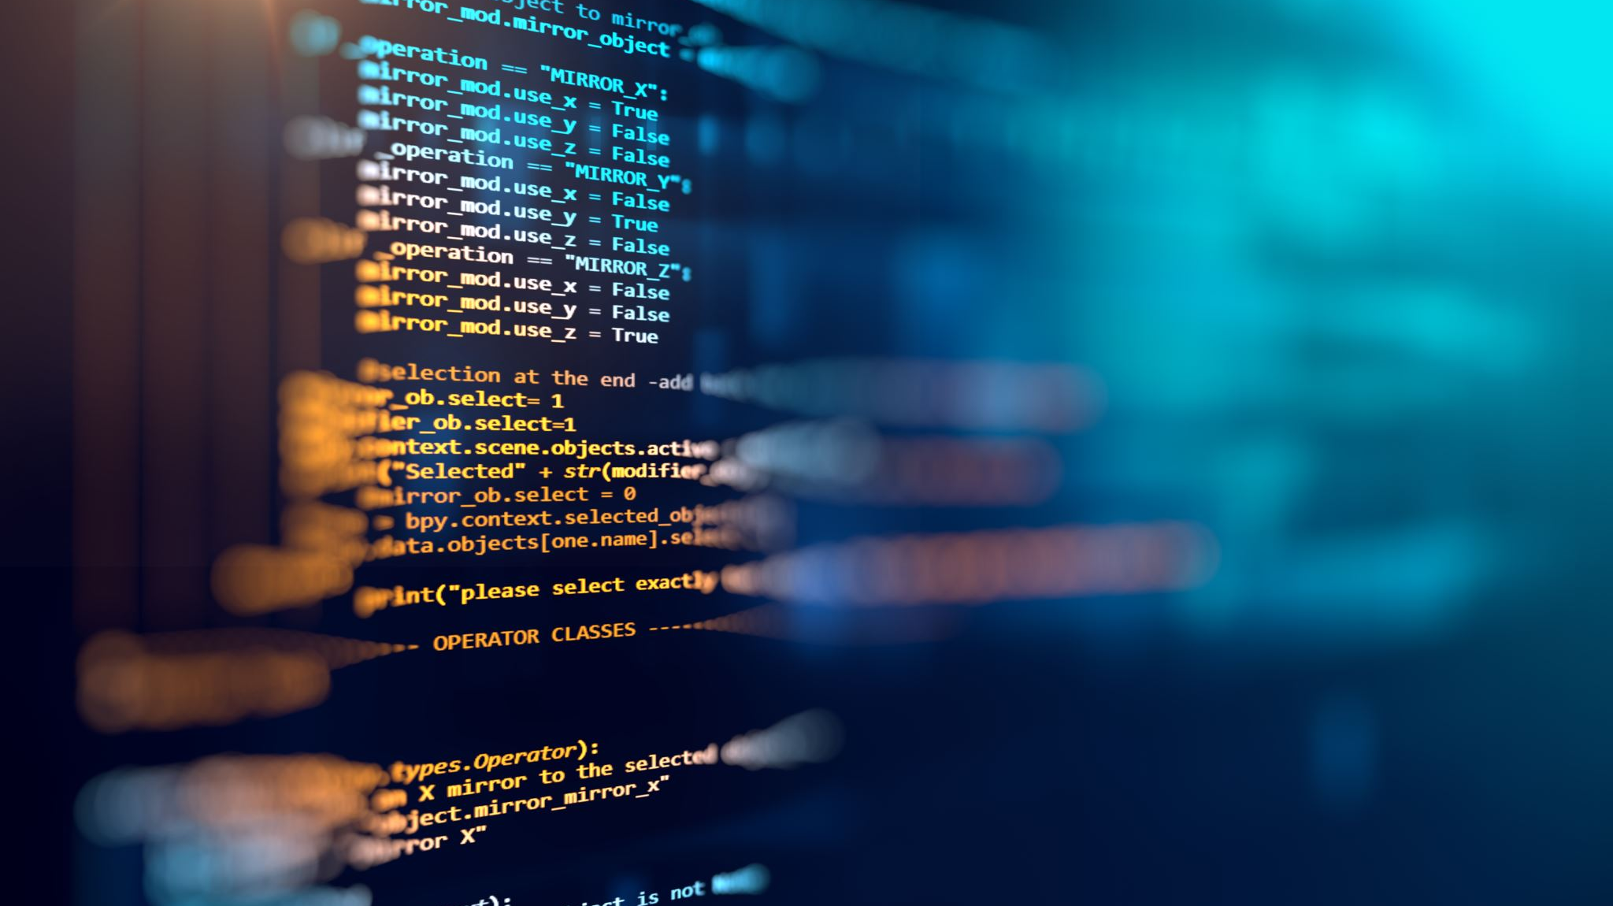
Phase 1, Module 1: Core Syntax & Professional Environments
Khyber AI Systems Engineer (KASE)
Welcome to KASE. Today, we don't just learn to code; we learn to build an environment where our code can survive in the real world.
Presented By: Zaryab Ahmad

Slide 2
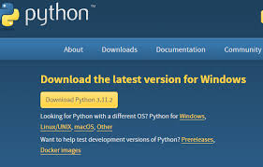
Installing 'The Brain' (Python)
Getting the Python Engine
Download Python 3.10+ from python.org/downloads.
CRITICAL: Check the box that says "Add Python.exe to PATH" during installation.
Without "PATH", your computer will not know Python exists.

Slide 3
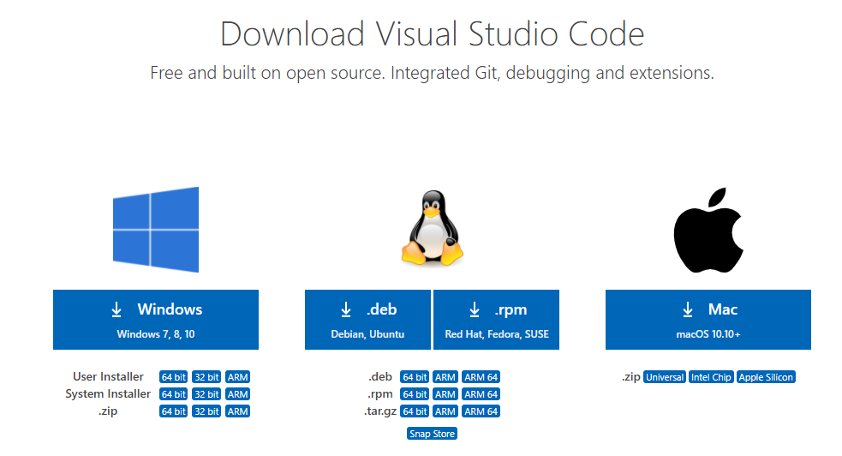
Building the Workbench (VS Code)
Visual Studio Code
We do not use browser-based Jupyter or basic text editors.
Download from code.visualstudio.com.
Install the Python and Jupyter extensions (by Microsoft) inside VS Code.
This Photo by Unknown Author is licensed under CC BY-NC-ND

Slide 4
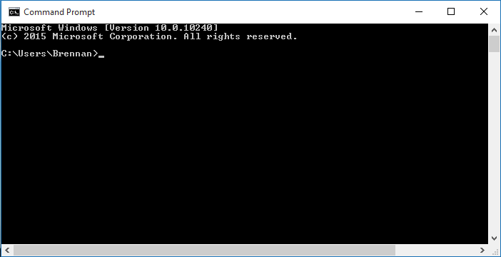
Verifying the Environment (CLI Test)
Talking to Your Computer
Open your Terminal or Command Prompt.
Run: python --version (Should output Python 3.1x.x).
Run: pip --version (Checks the package installer).

Slide 5
The Python Interpreter
How Python "Thinks“
Python is an Interpreted language (reads line-by-line).
Slower than C++ for the machine, but 10x faster for the human developer.
The engine behind the global AI revolution.

Slide 6
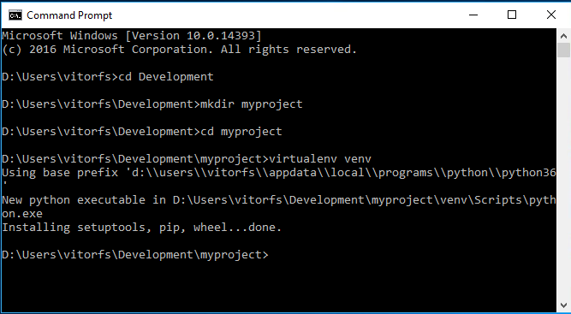
The Virtual Environment (VENV)
The Golden Rule: Never Install Globally
What is it? A quarantined room for your project's tools.
Why? Prevents version crashes between different projects.
The Command: python -m venv kase_env

Slide 7
PEP 8 - The Law of Clean Code
Writing Code for Humans
Code is read 100 times more often than it is written.
PEP 8 is the global style guide.
Variables: snake_case | Constants: UPPER_CASE.
Indentation: Exactly 4 spaces.

